Slide 1

Sophisticated present bias examples
Notes on Behavioural Economics
Jason Collins

Slide 2
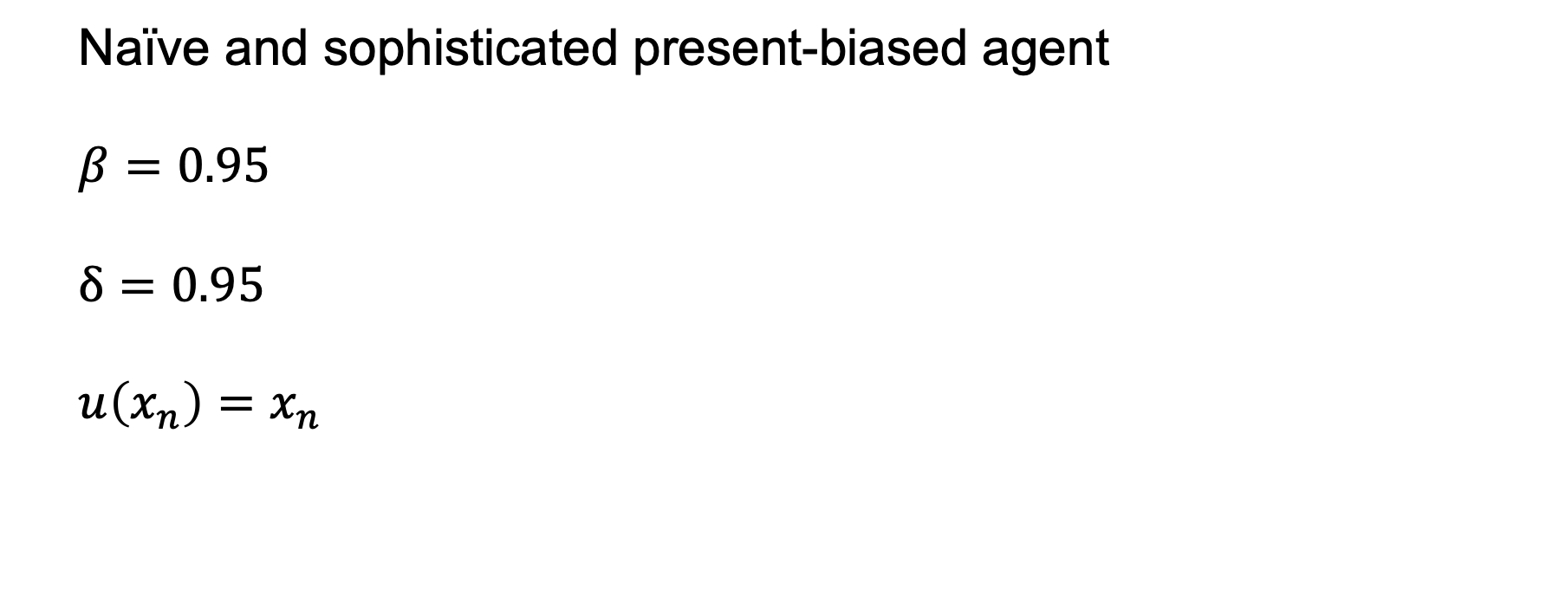
Naïve and sophisticated present-biased agent
$$β=0.95$$
$$δ=0.95$$
$$u\left(x_{n}\right)=x_{n}$$

Slide 3
$100 next week or $110 in two weeks?

Slide 4
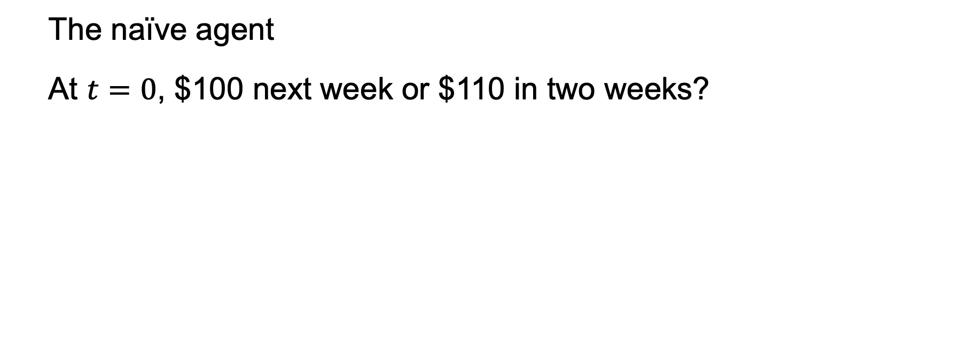
The naïve agent
At $t=0$, $100 next week or $110 in two weeks?

Slide 5
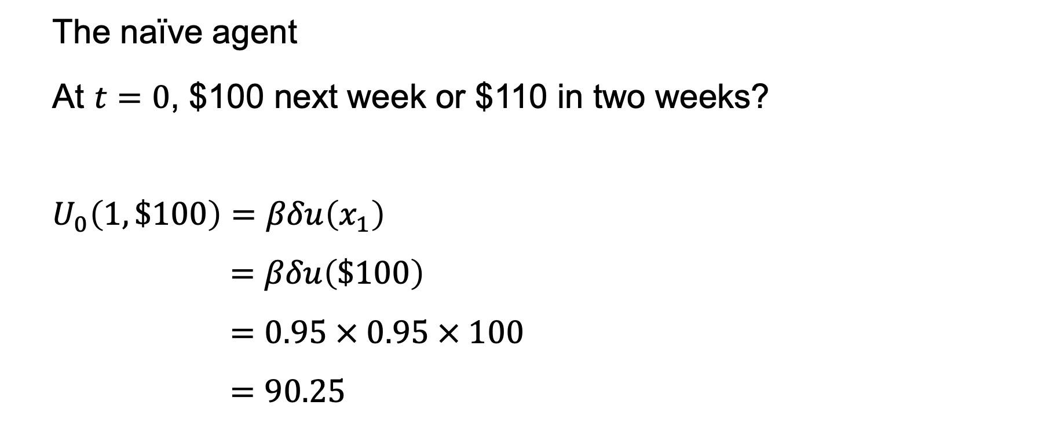
The naïve agent
At $t=0$, $100 next week or $110 in two weeks?
$$U_{0}\left(1,\$100\right)=βδu\left(x_{1}\right)$$
$$=βδu\left(\$100\right)$$
$$=0.95 × 0.95 × 100$$
$$=90.25$$

Slide 6
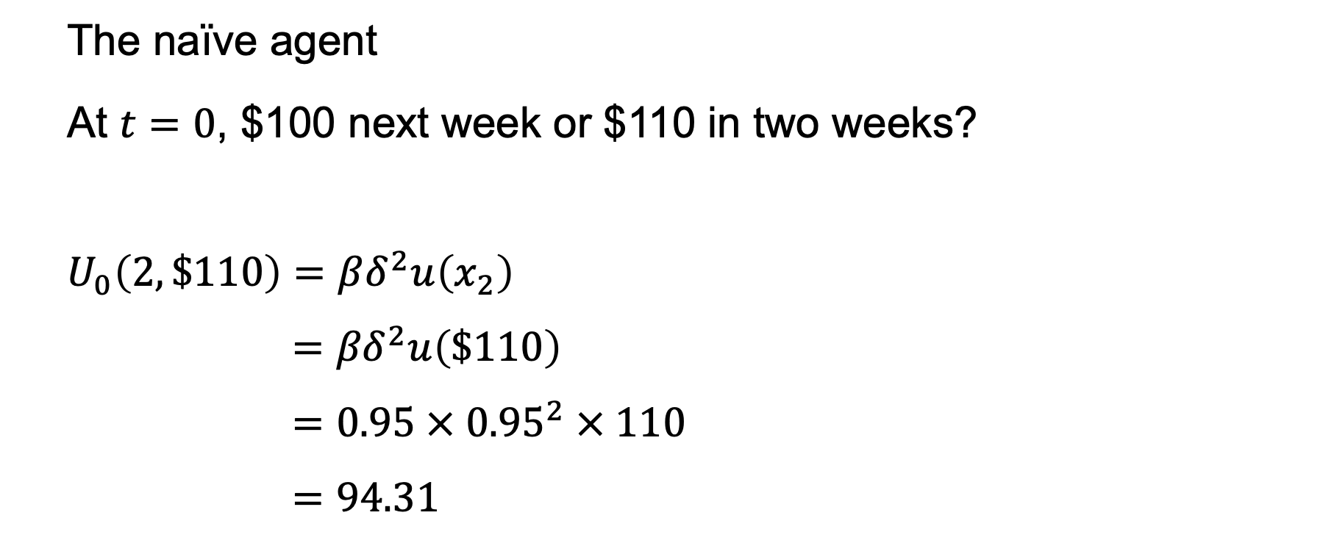
The naïve agent
At $t=0$, $100 next week or $110 in two weeks?
$$U_{0}\left(2,\$110\right)=βδ^{2}u\left(x_{2}\right)$$
$$={βδ}^{2}u\left(\$110\right)$$
$$=0.95 × {0.95}^{2} × 110$$
$$=94.31$$

Slide 7
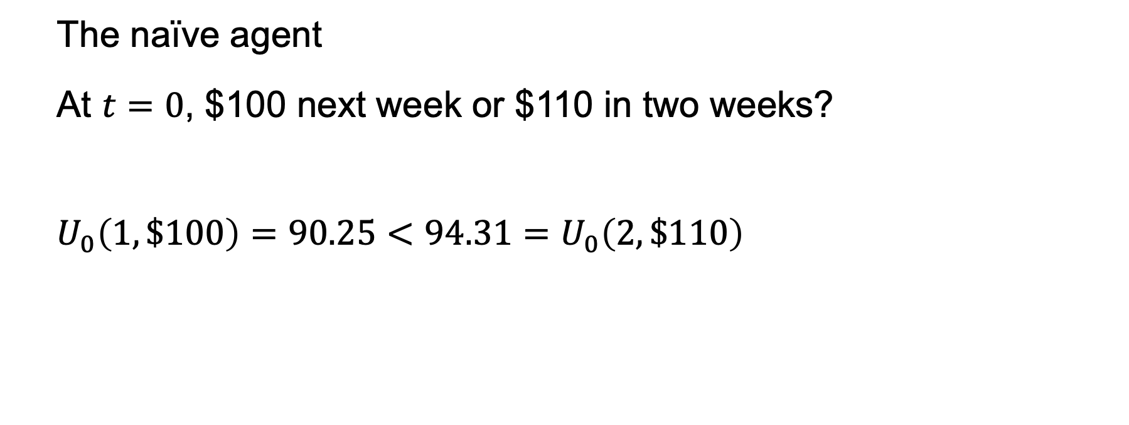
The naïve agent
At $t=0$, $100 next week or $110 in two weeks?
$$U_{0}\left(1,\$100\right)=90.25<94.31=U_{0}\left(2,\$110\right)$$

Slide 8
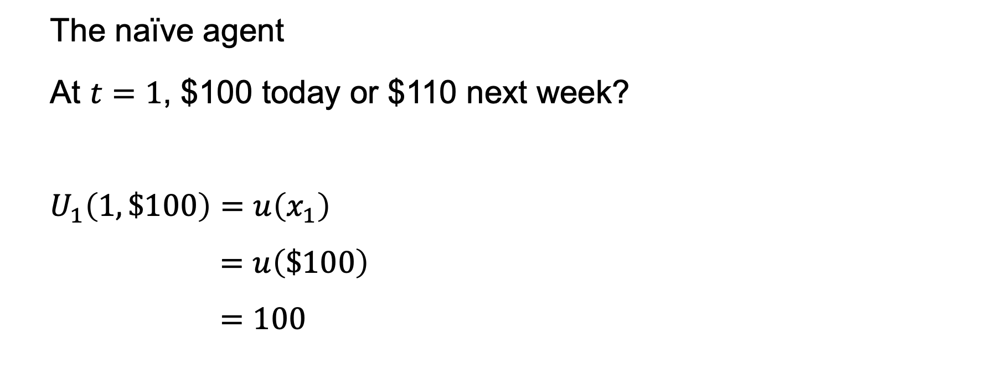
The naïve agent
At $t=1$, $100 today or $110 next week?
$$U_{1}\left(1,\$100\right)=u\left(x_{1}\right)$$
$$=u\left(\$100\right)$$
$$=100$$

Slide 9
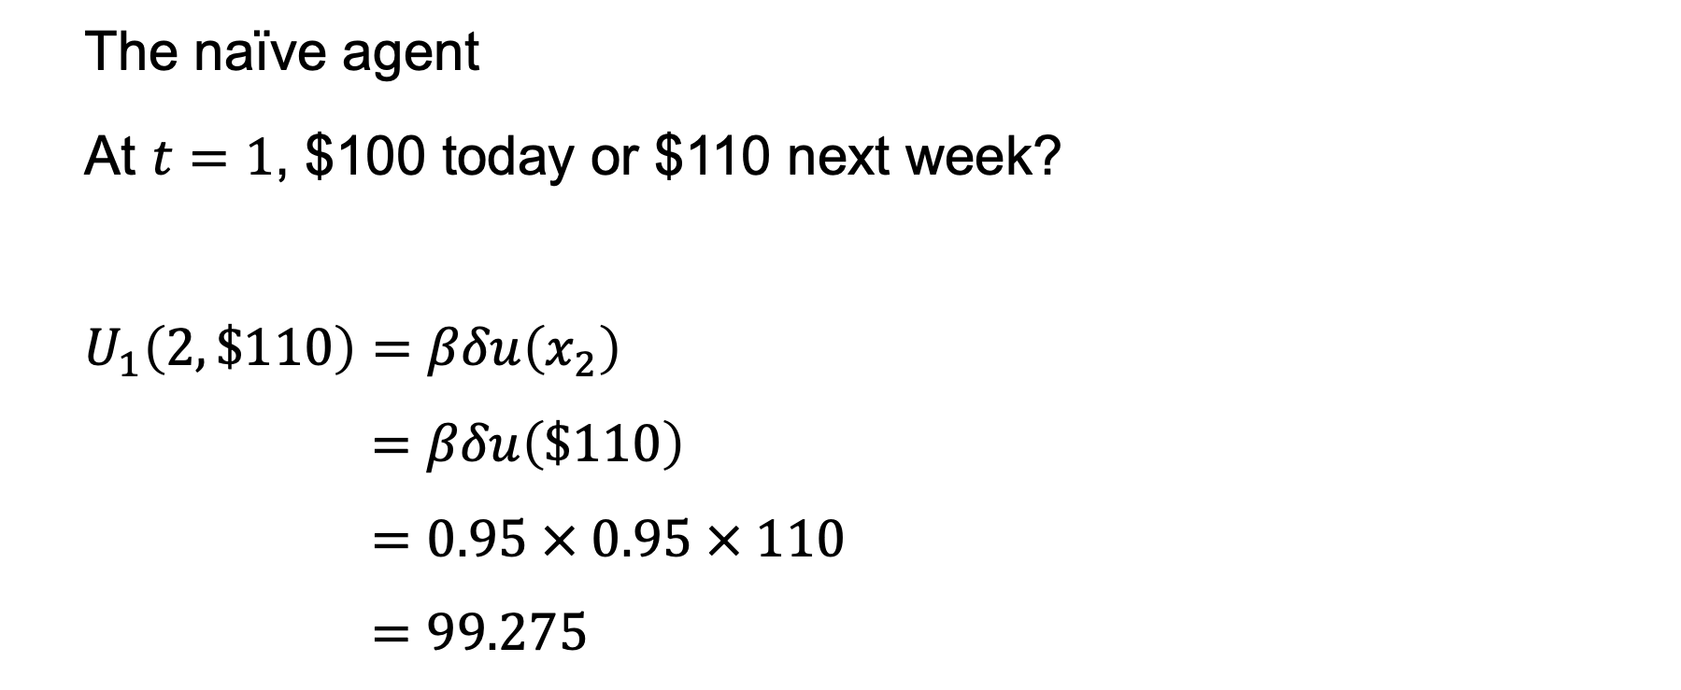
The naïve agent
At $t=1$, $100 today or $110 next week?
$$U_{1}\left(2,\$110\right)=βδu\left(x_{2}\right)$$
$$=βδu\left(\$110\right)$$
$$=0.95 × 0.95 × 110$$
$$=99.275$$

Slide 10
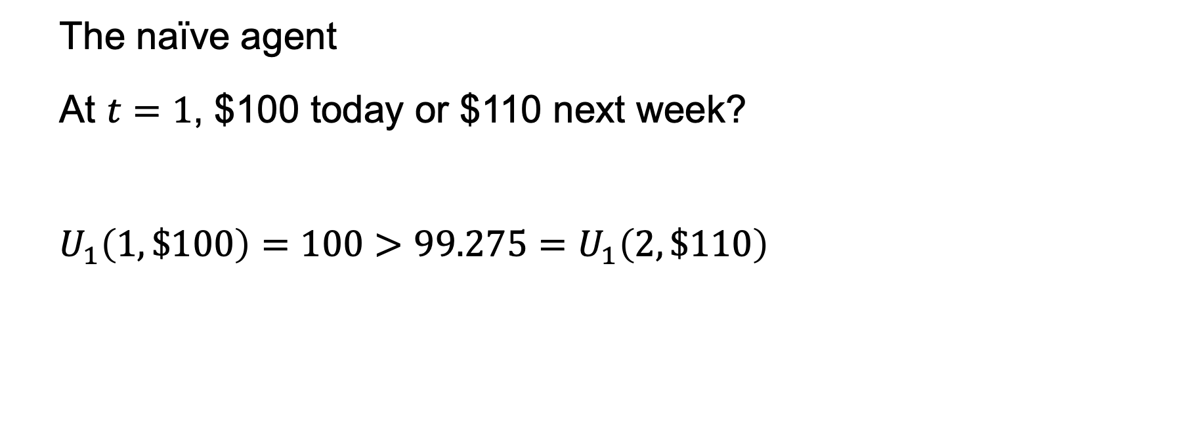
The naïve agent
At $t=1$, $100 today or $110 next week?
$$U_{1}\left(1,\$100\right)=100>99.275=U_{1}\left(2,\$110\right)$$

Slide 11
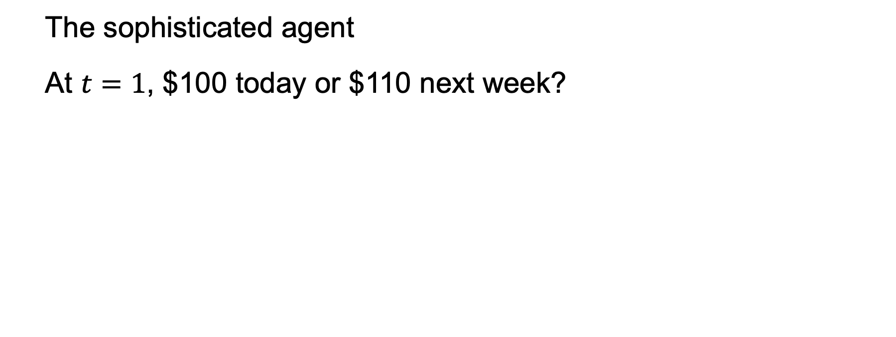
The sophisticated agent
At $t=1$, $100 today or $110 next week?

Slide 12
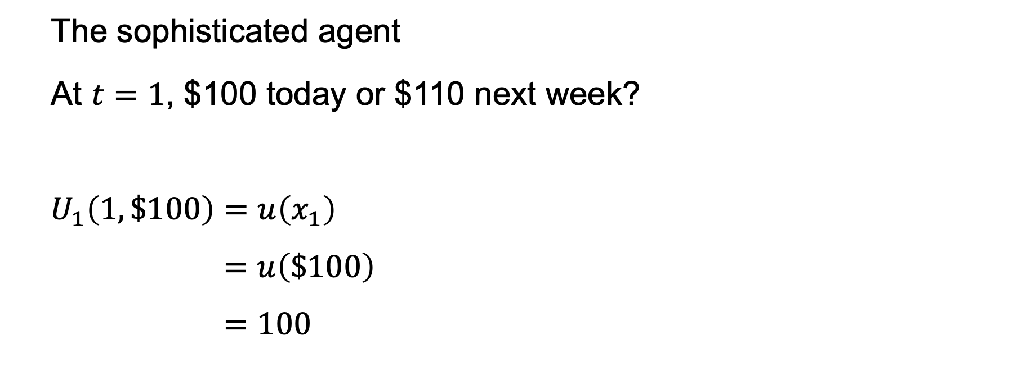
The sophisticated agent
At $t=1$, $100 today or $110 next week?
$$U_{1}\left(1,\$100\right)=u\left(x_{1}\right)$$
$$=u\left(\$100\right)$$
$$=100$$

Slide 13
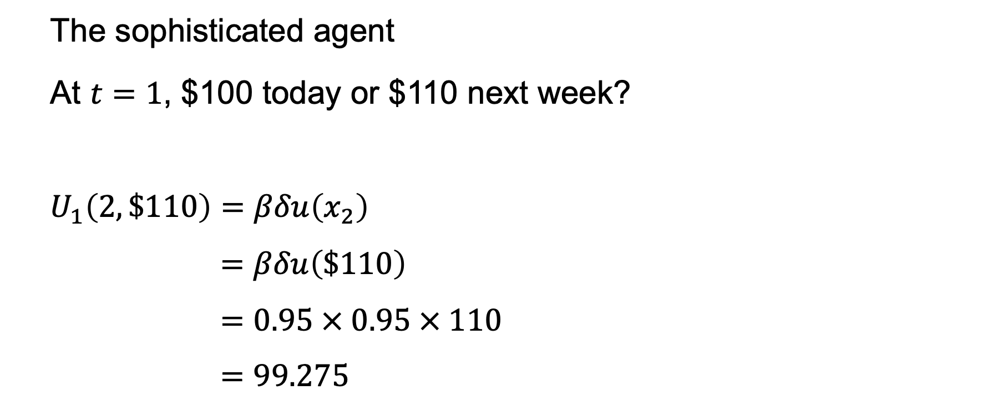
The sophisticated agent
At $t=1$, $100 today or $110 next week?
$$U_{1}\left(2,\$110\right)=βδu\left(x_{2}\right)$$
$$=βδu\left(\$110\right)$$
$$=0.95 × 0.95 × 110$$
$$=99.275$$

Slide 14
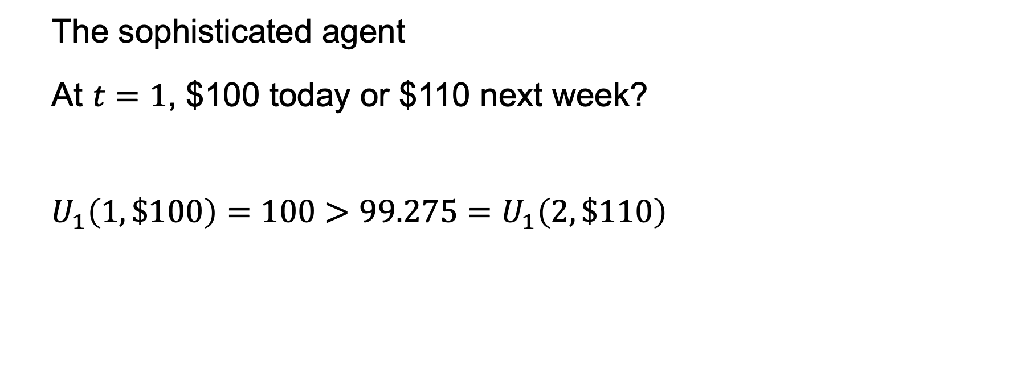
The sophisticated agent
At $t=1$, $100 today or $110 next week?
$$U_{1}\left(1,\$100\right)=100>99.275=U_{1}\left(2,\$110\right)$$

Slide 15
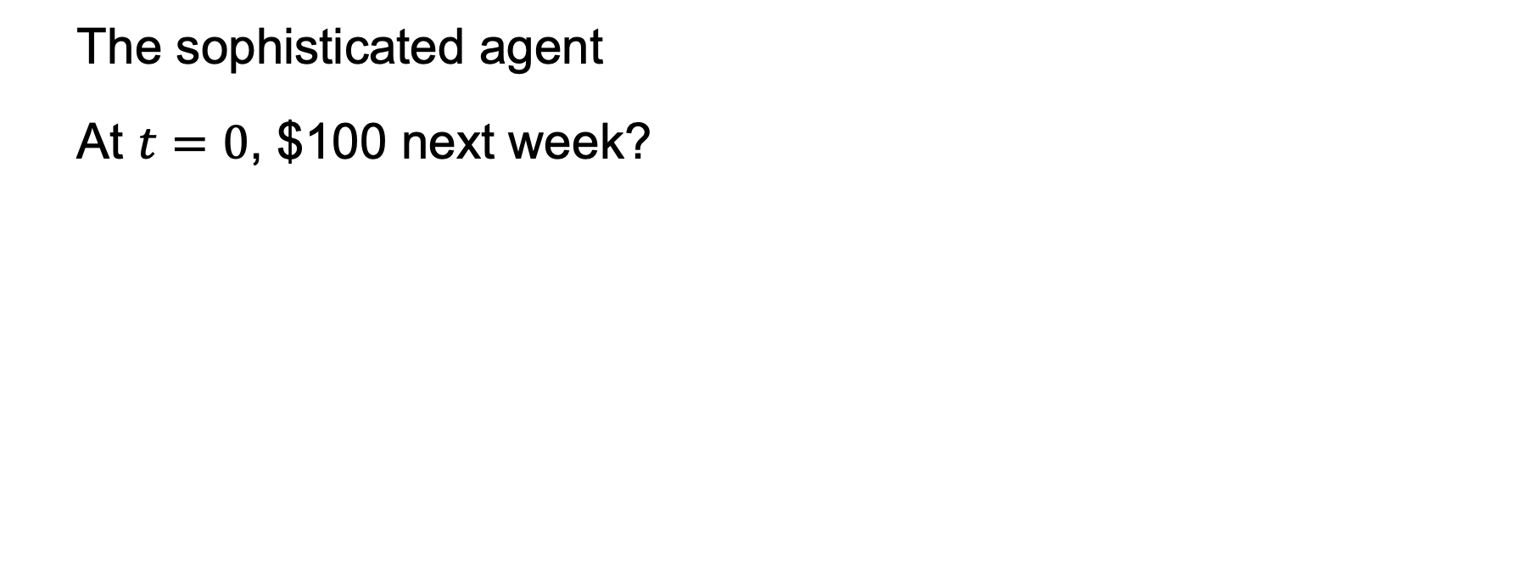
The sophisticated agent
At $t=0$, $100 next week?

Slide 16
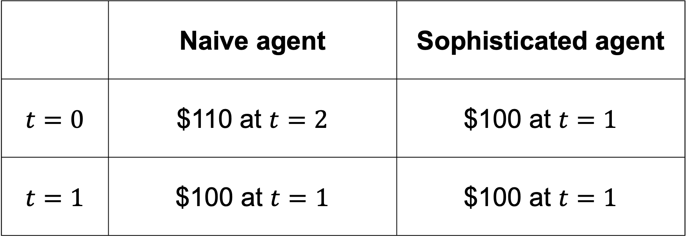
 | Naive agent | Sophisticated agent
$$t=0$$ | $110 at $t=2$ | $100 at $t=1$
$$t=1$$ | $100 at $t=1$ | $100 at $t=1$

Slide 17
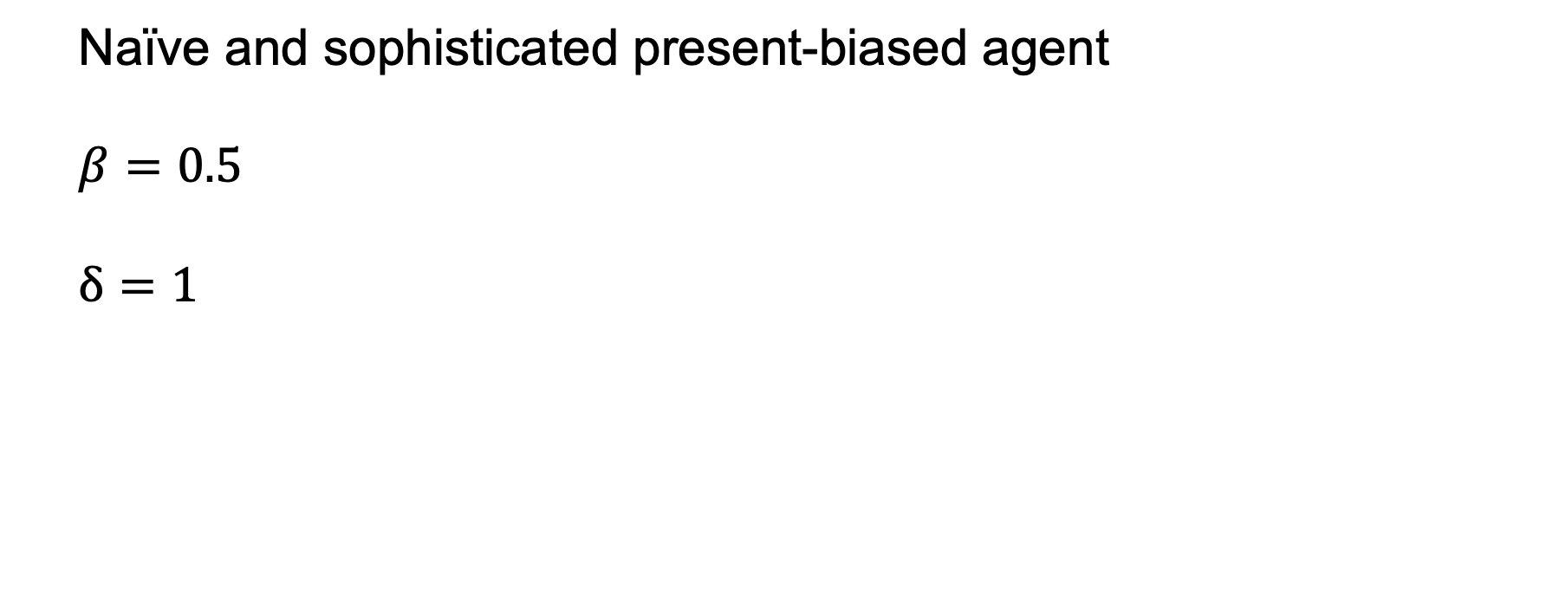
Naïve and sophisticated present-biased agent
$$β=0.5$$
$$δ=1$$

Slide 18
OK movie: 6
Good movie: 10
Great movie: 16

Slide 19
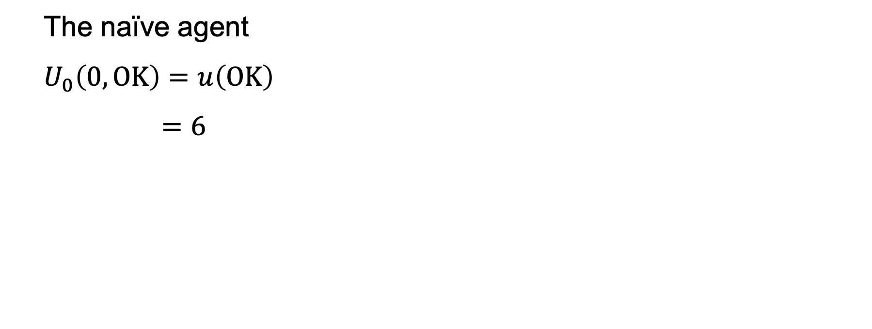
The naïve agent
$$U_{0}\left(0,OK\right)=u\left(OK\right)$$
$$=6$$

Slide 20
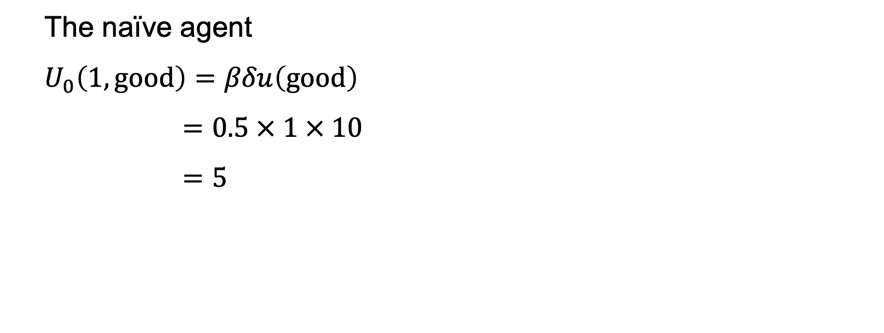
The naïve agent
$$U_{0}\left(1, good\right)=βδu\left(good\right)$$
$$=0.5 × 1 × 10$$
$$=5$$

Slide 21
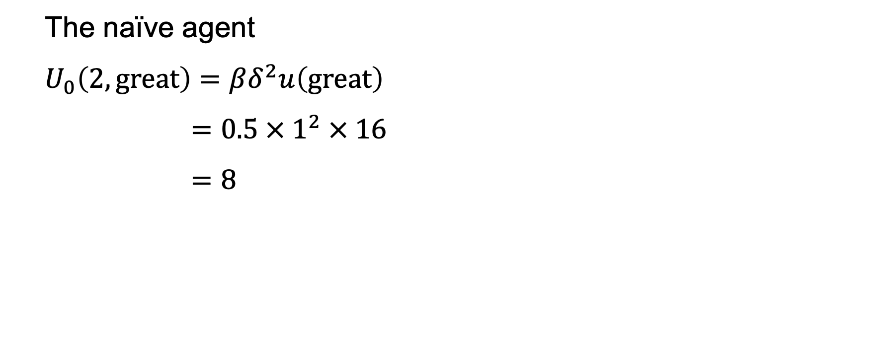
The naïve agent
$$U_{0}\left(2, great\right)=βδ^{2}u\left(great\right)$$
$$=0.5 ×{ 1}^{2} × 16$$
$$=8$$

Slide 22
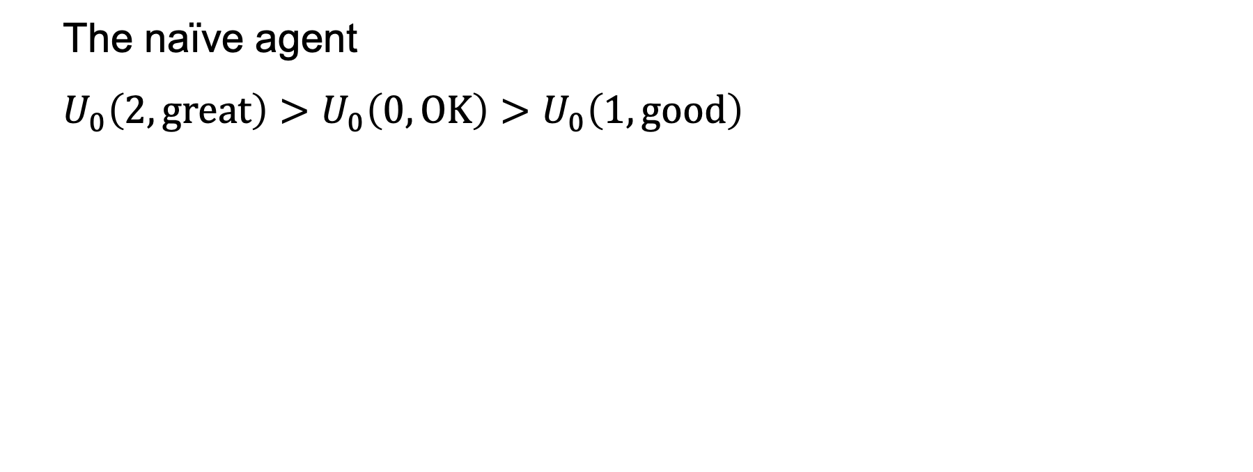
The naïve agent
$$U_{0}\left(2,great\right)>U_{0}\left(0,OK\right)>U_{0}\left(1,good\right)$$

Slide 23
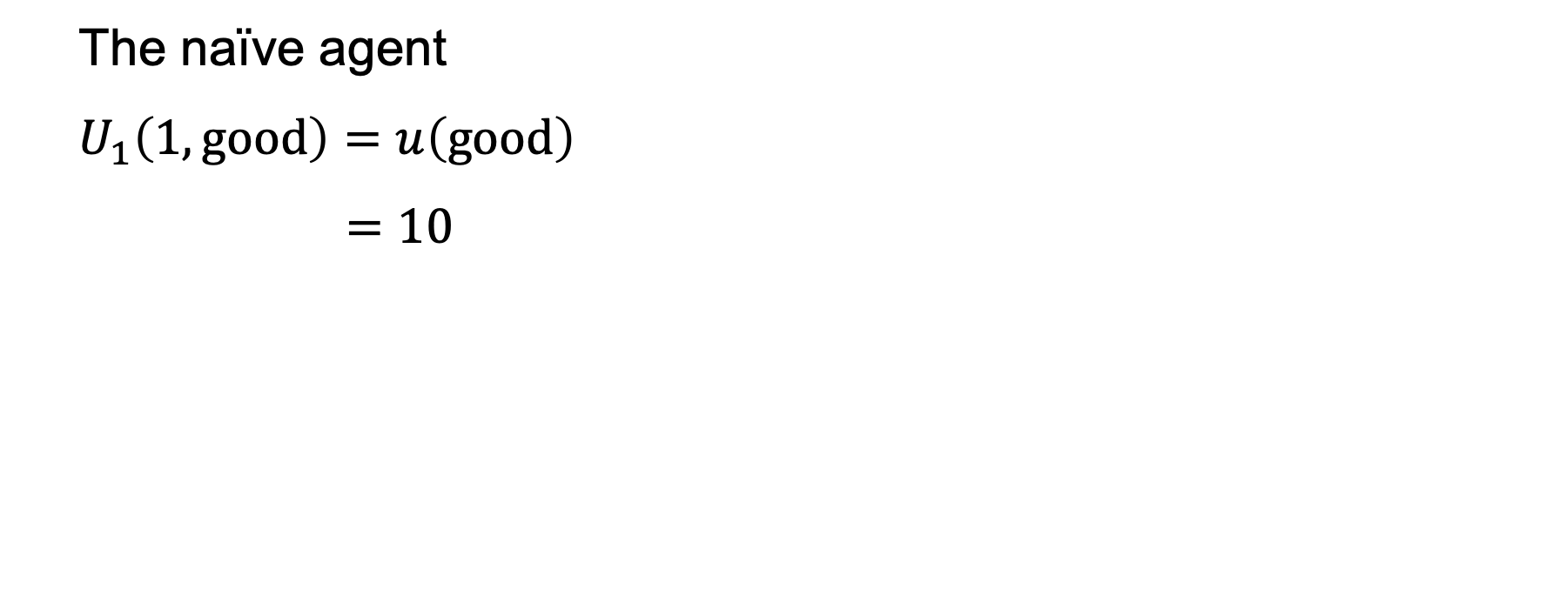
The naïve agent
$$U_{1}\left(1,good\right)=u\left(good\right)$$
$$=10$$

Slide 24
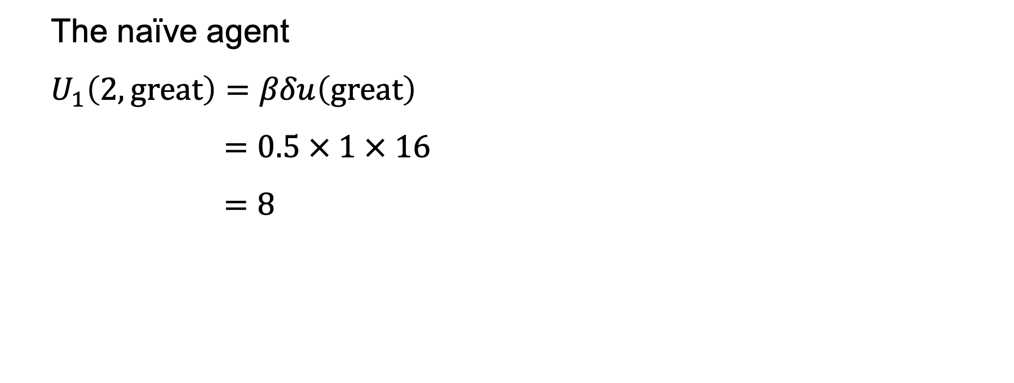
The naïve agent
$$U_{1}\left(2, great\right)=βδu\left(great\right)$$
$$=0.5 × 1 × 16$$
$$=8$$

Slide 25
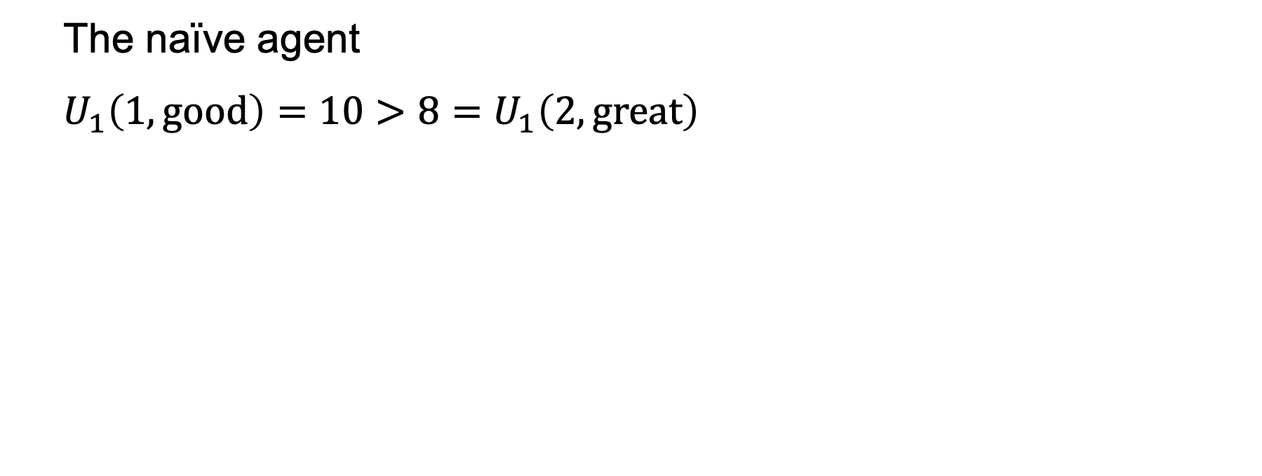
The naïve agent
$$U_{1}\left(1,good\right)=10>8=U_{1}\left(2,great\right)$$

Slide 26
The sophisticated agent

Slide 27
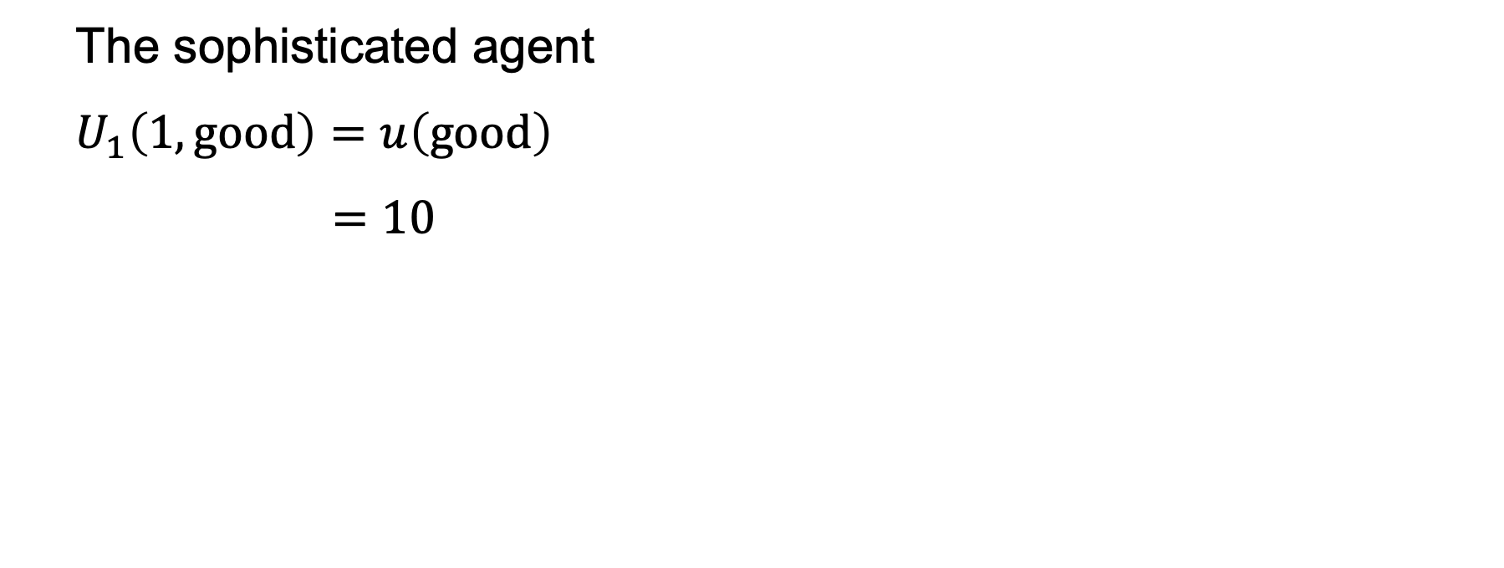
The sophisticated agent
$$U_{1}\left(1,good\right)=u\left(good\right)$$
$$=10$$

Slide 28
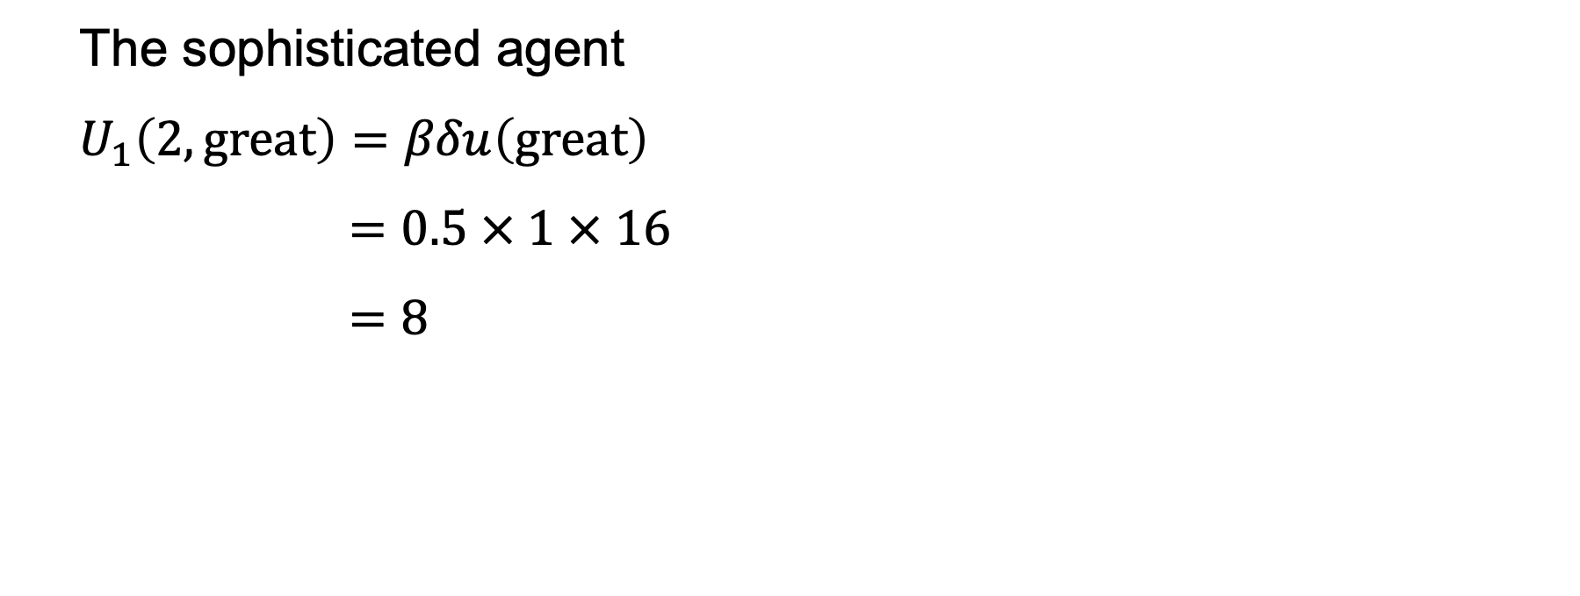
The sophisticated agent
$$U_{1}\left(2, great\right)=βδu\left(great\right)$$
$$=0.5 × 1 × 16$$
$$=8$$

Slide 29
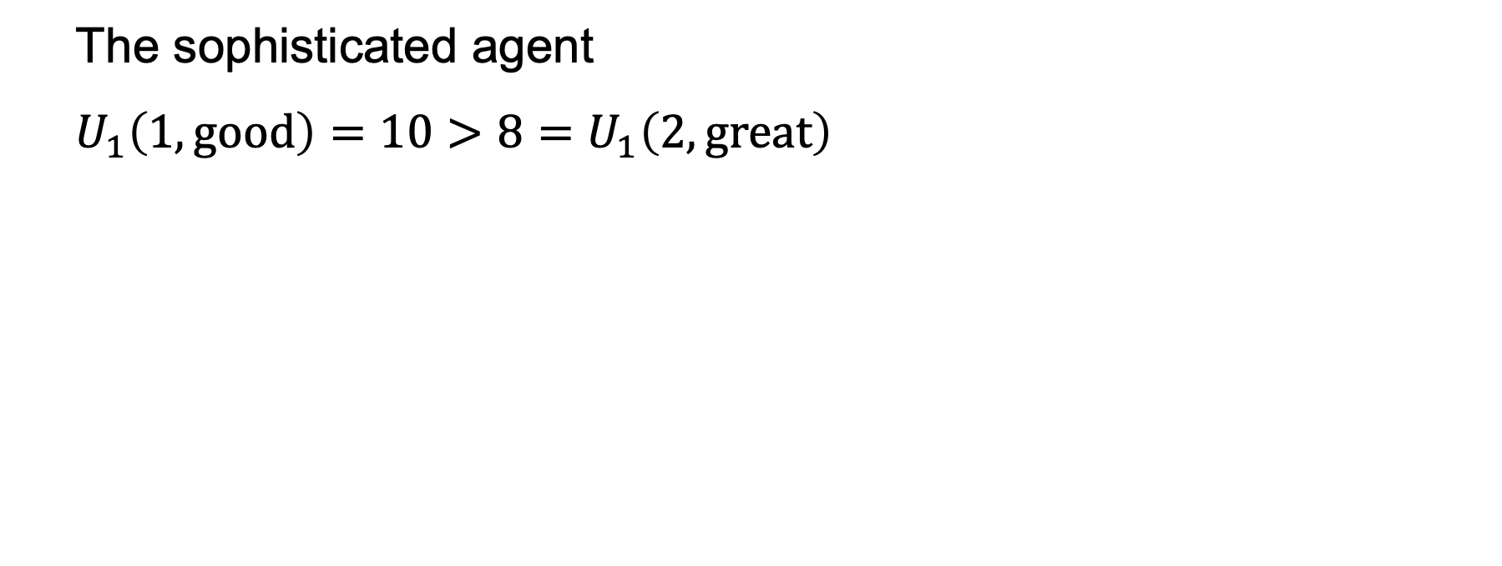
The sophisticated agent
$$U_{1}\left(1,good\right)=10>8=U_{1}\left(2,great\right)$$

Slide 30
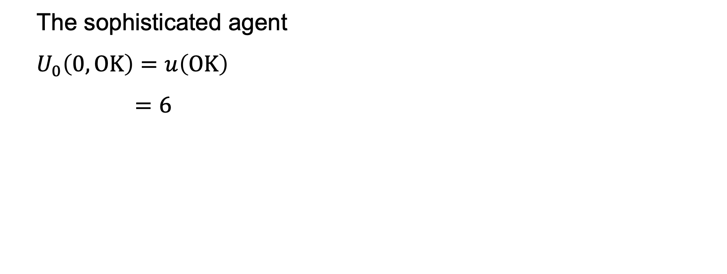
The sophisticated agent
$$U_{0}\left(0,OK\right)=u\left(OK\right)$$
$$=6$$

Slide 31
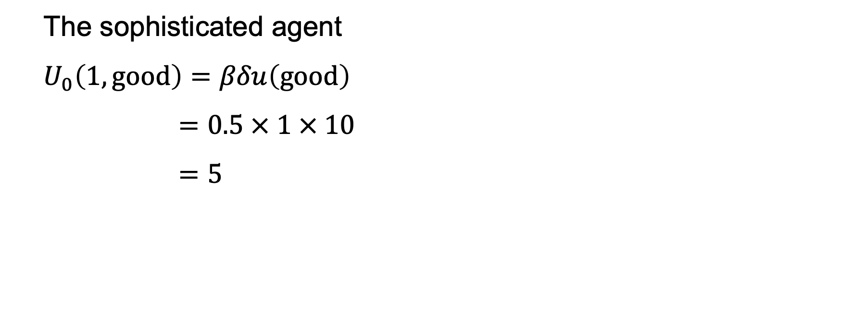
The sophisticated agent
$$U_{0}\left(1, good\right)=βδu\left(good\right)$$
$$=0.5 × 1 × 10$$
$$=5$$

Slide 32
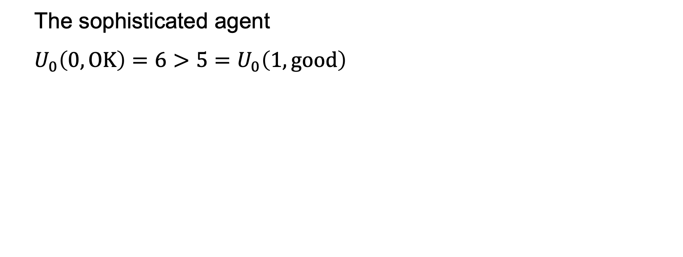
The sophisticated agent
$$U_{0}\left(0,OK\right)=6>5=U_{0}\left(1,good\right)$$

Slide 33

(0, -$10)
(1, -$15)
(2, -$25)

Slide 34
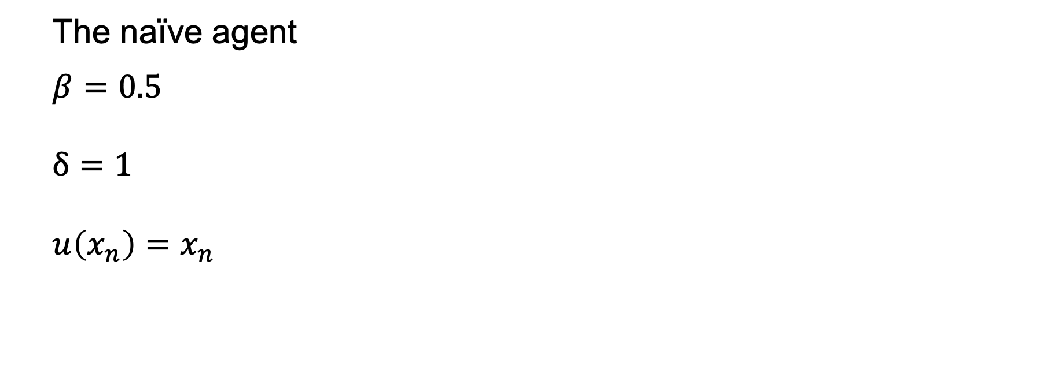
The naïve agent
$$β=0.5$$
$$δ=1$$
$$u\left(x_{n}\right)=x_{n}$$

Slide 35
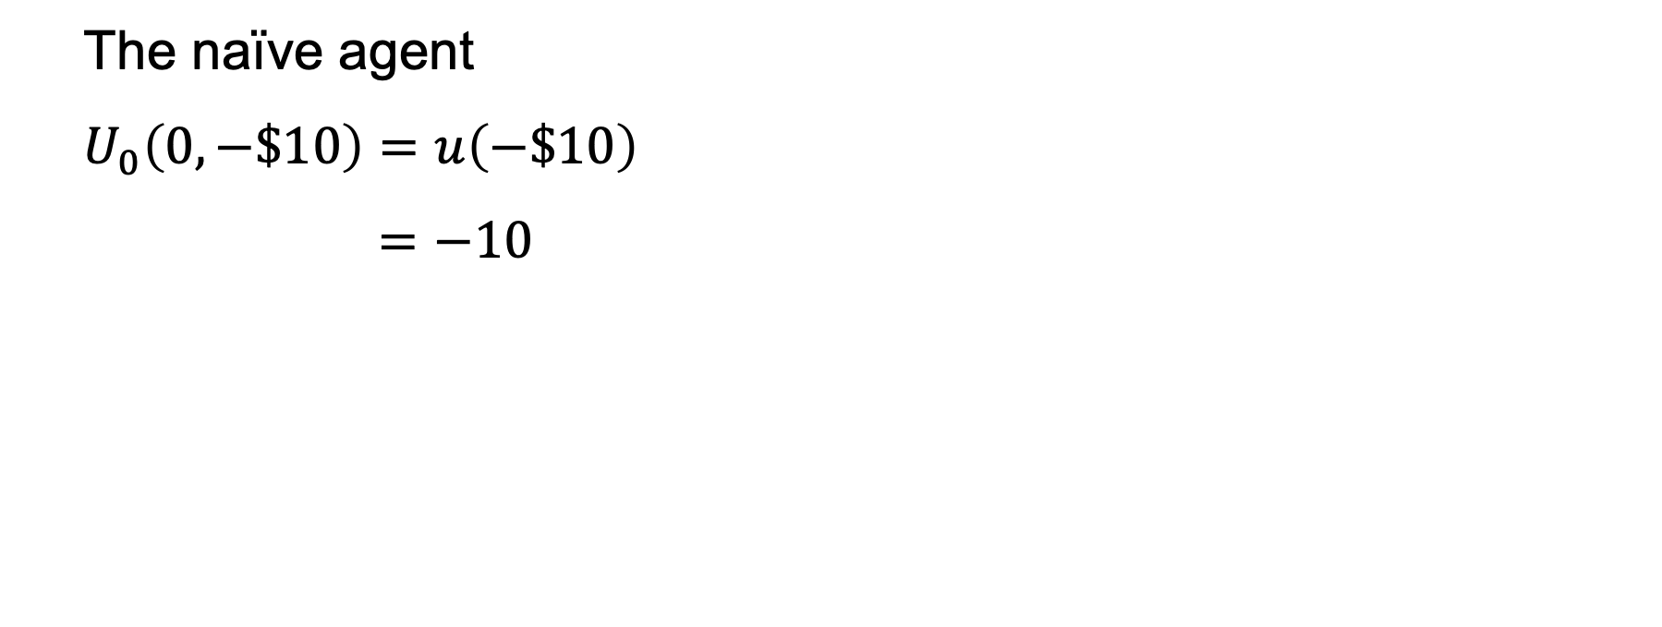
The naïve agent
$$U_{0}\left(0,−\$10\right)=u\left(−\$10\right)$$
$$=−10$$

Slide 36
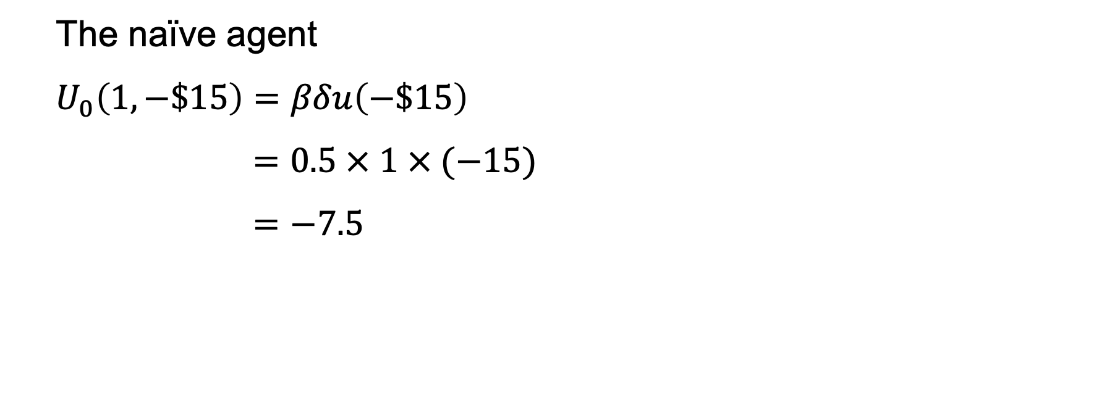
The naïve agent
$$U_{0}\left(1,−\$15\right)=βδu\left(−\$15\right)$$
$$=0.5 × 1 × (−15)$$
$$=−7.5$$

Slide 37
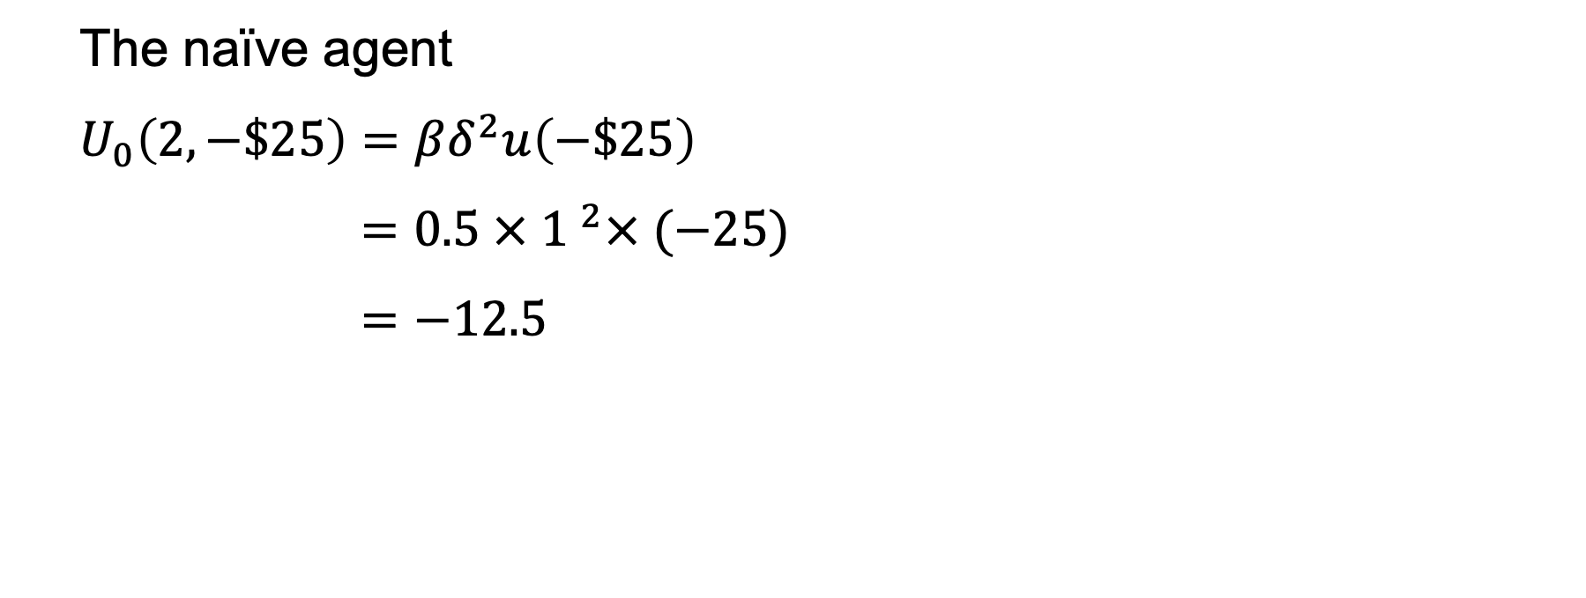
The naïve agent
$$U_{0}\left(2,−\$25\right)=βδ^{2}u\left(−\$25\right)$$
$$=0.5 × {1 }^{2}× (−25)$$
$$=−12.5$$

Slide 38
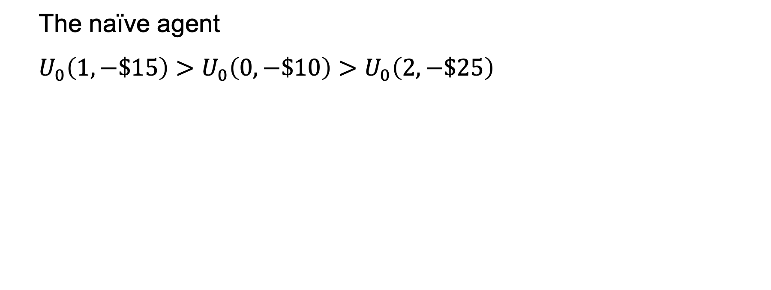
The naïve agent
$$U_{0}\left(1,−\$15\right)>U_{0}\left(0,−\$10\right)>U_{0}\left(2,−\$25\right)$$

Slide 39
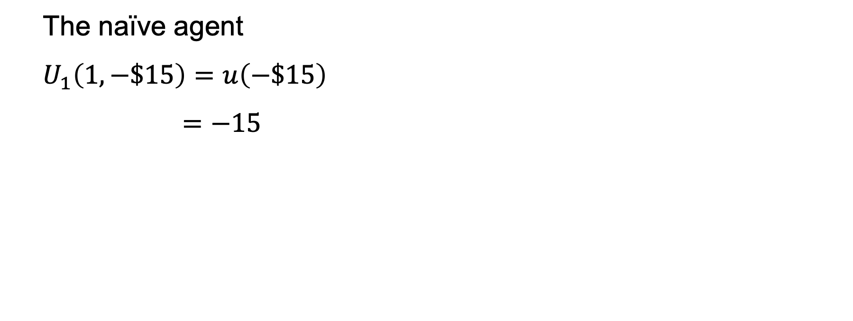
The naïve agent
$$U_{1}\left(1,−\$15\right)=u\left(−\$15\right)$$
$$=−15$$

Slide 40
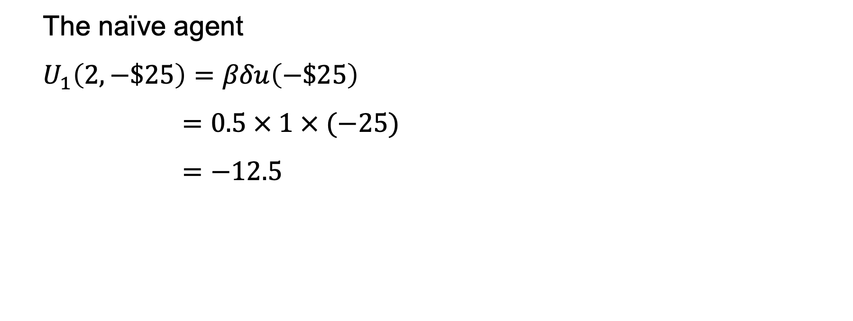
The naïve agent
$$U_{1}\left(2,−\$25\right)=βδu\left(−\$25\right)$$
$$=0.5 × 1 × (−25)$$
$$=−12.5$$

Slide 41
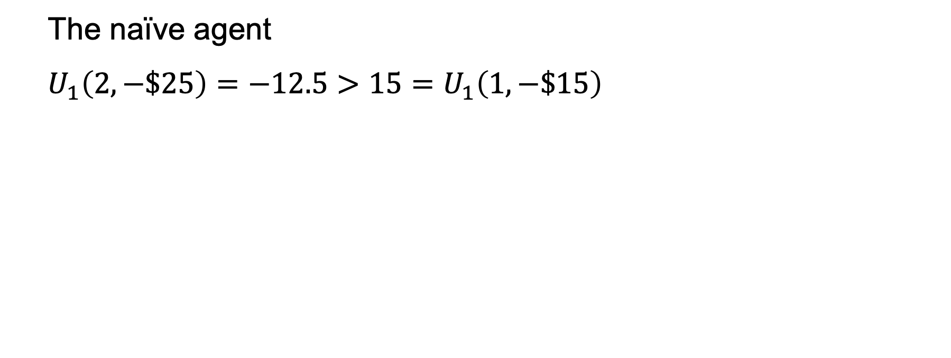
The naïve agent
$$U_{1}\left(2,−\$25\right)=−12.5>15=U_{1}\left(1,−\$15\right)$$

Slide 42
(0, -$10)
(1, -$15)
(2, -$25)

Slide 43
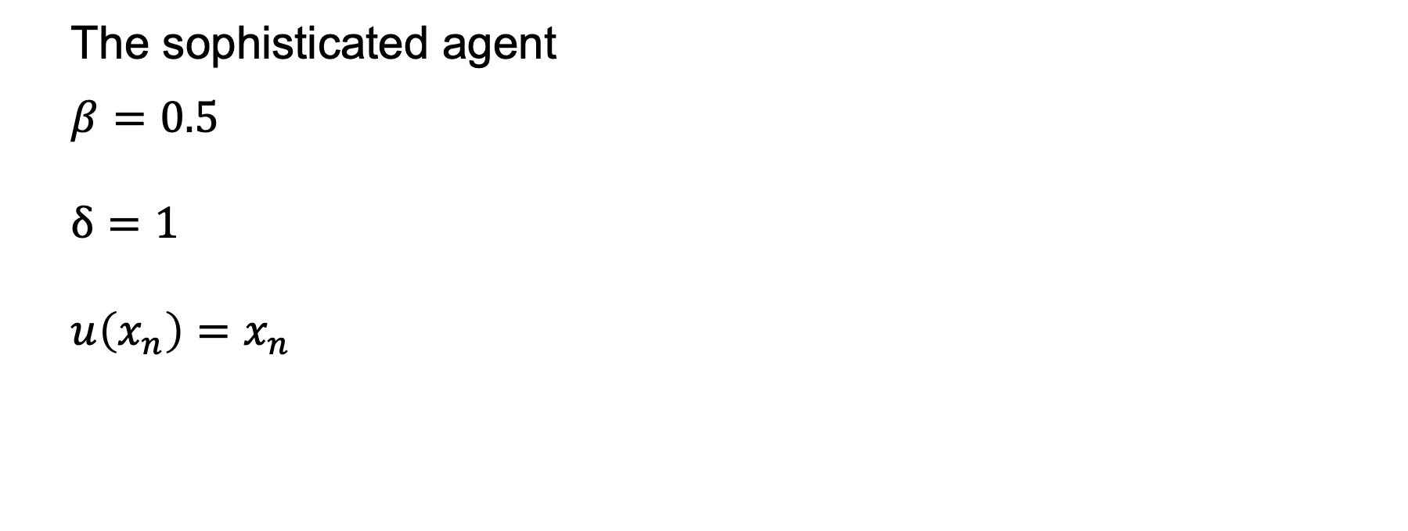
The sophisticated agent
$$β=0.5$$
$$δ=1$$
$$u\left(x_{n}\right)=x_{n}$$

Slide 44
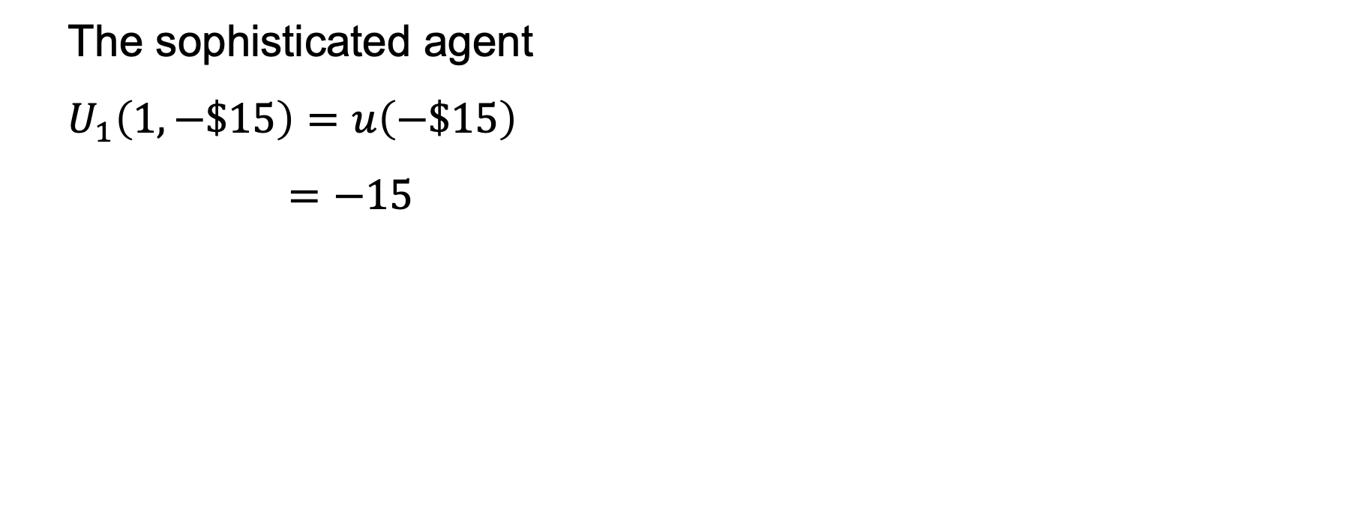
The sophisticated agent
$$U_{1}\left(1,−\$15\right)=u\left(−\$15\right)$$
$$=−15$$

Slide 45
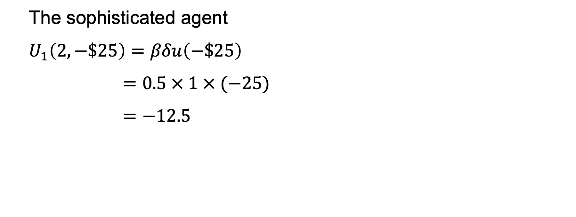
The sophisticated agent
$$U_{1}\left(2,−\$25\right)=βδu\left(−\$25\right)$$
$$=0.5 × 1 × (−25)$$
$$=−12.5$$

Slide 46
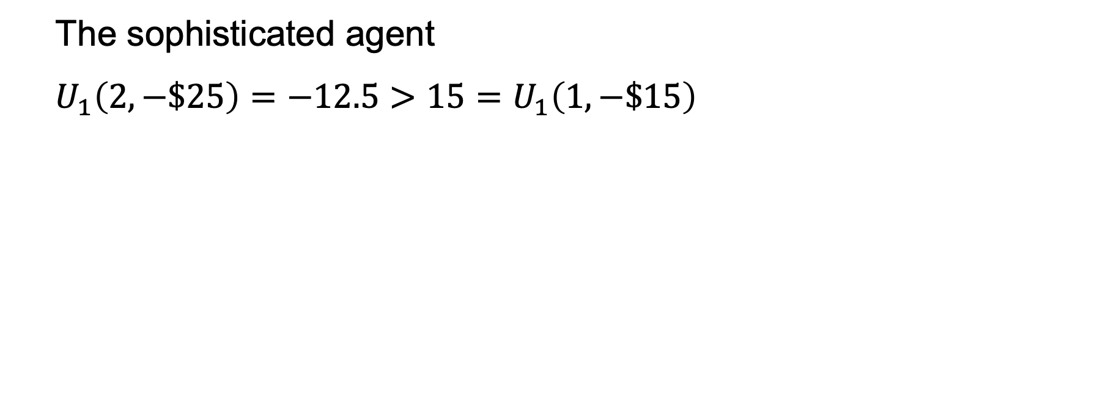
The sophisticated agent
$$U_{1}\left(2,−\$25\right)=−12.5>15=U_{1}\left(1,−\$15\right)$$

Slide 47
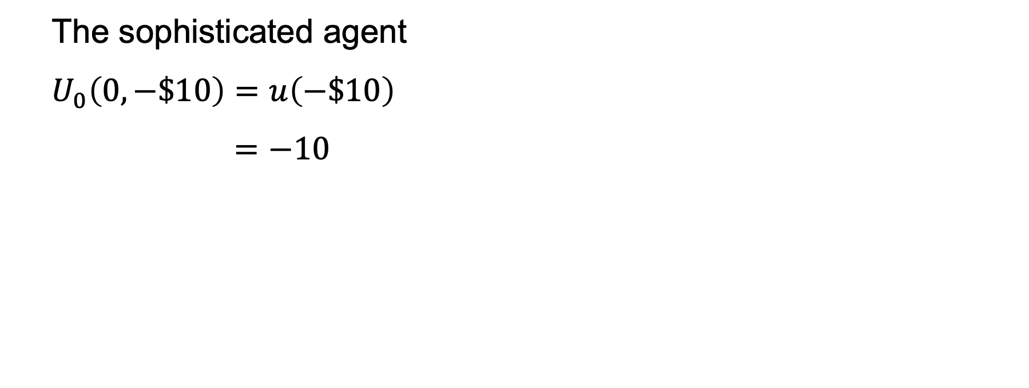
The sophisticated agent
$$U_{0}\left(0,−\$10\right)=u\left(−\$10\right)$$
$$=−10$$

Slide 48
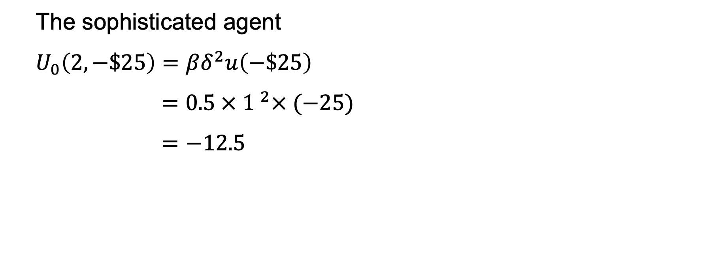
The sophisticated agent
$$U_{0}\left(2,−\$25\right)=βδ^{2}u\left(−\$25\right)$$
$$=0.5 × {1 }^{2}× (−25)$$
$$=−12.5$$

Slide 49
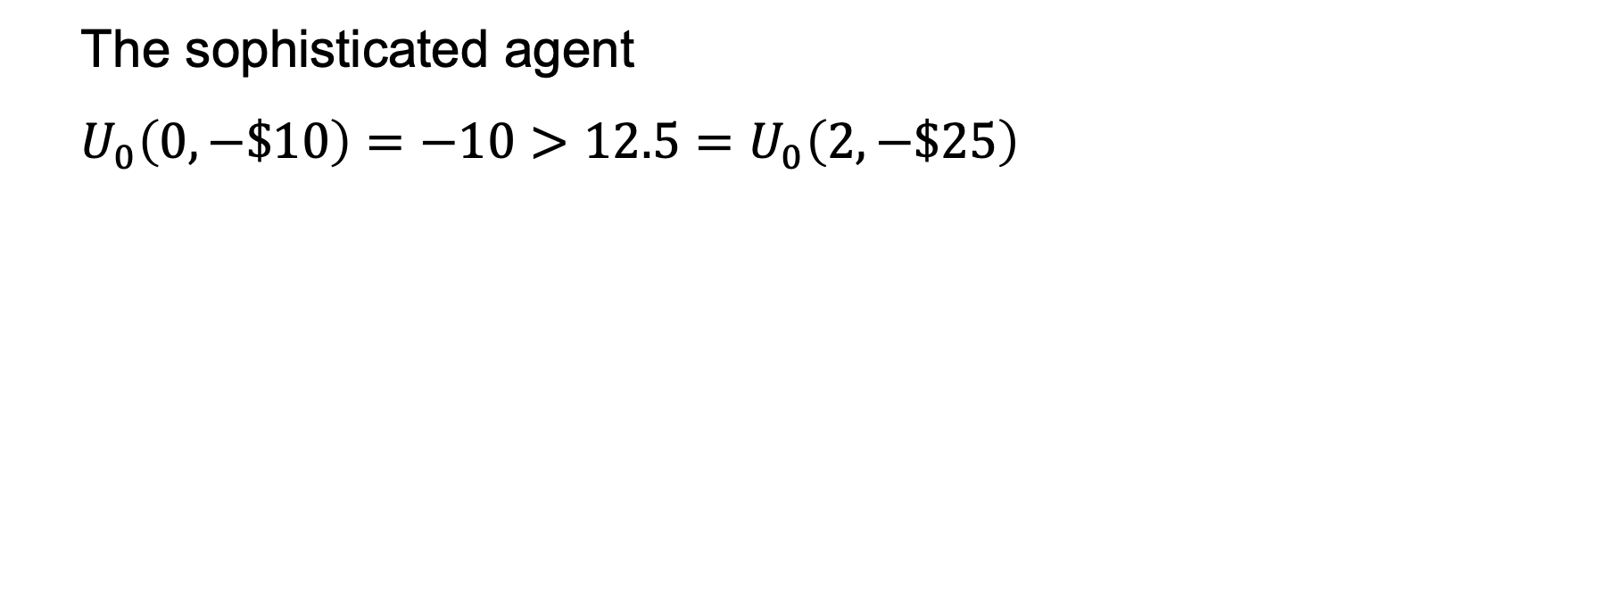
The sophisticated agent
$$U_{0}\left(0,−\$10\right)=−10>12.5=U_{0}\left(2,−\$25\right)$$

Slide 50
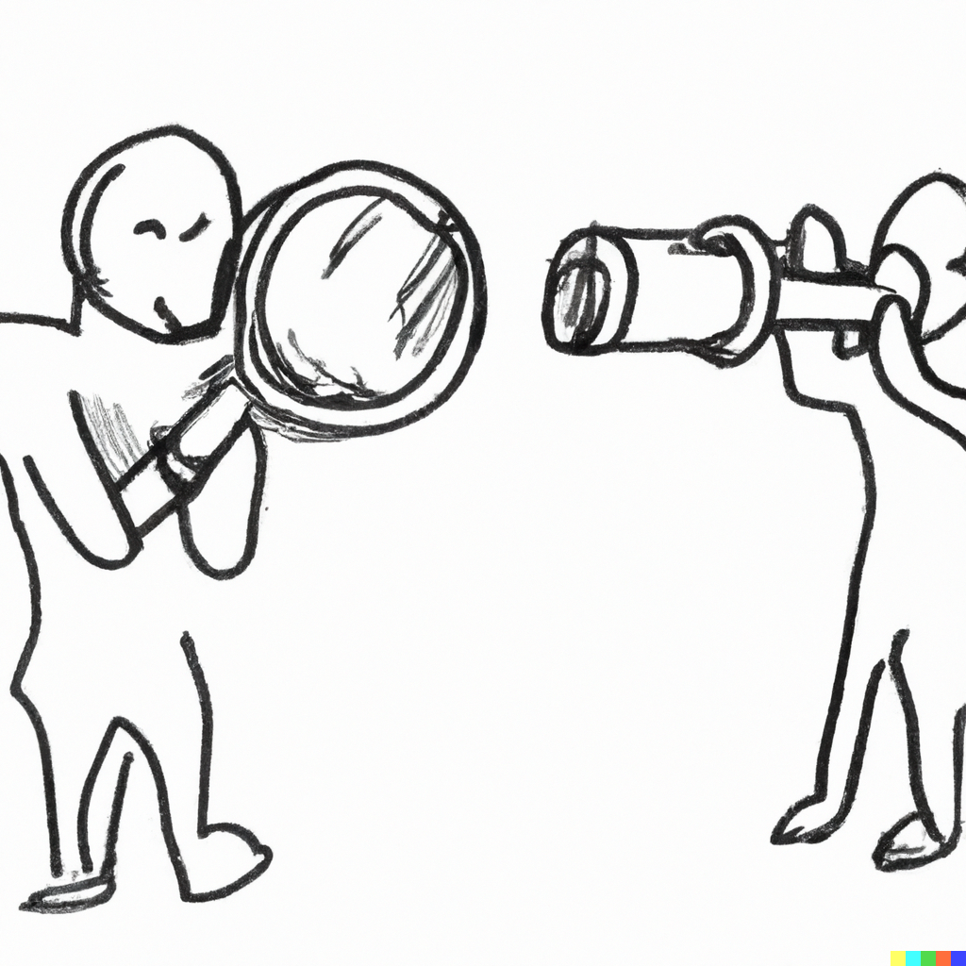
Naïve
Sophisticated

